Slide 1
Enterprise Web Software Development
COMP1640

Slide 2
Lecturer
Full name: Nguyen Dinh Tran Long
Email: longndt@fpt.edu.vn

Slide 3
Outcome
Apply your skills and knowledge in a realistic group project to develop a specific enterprise web system using Agile Scrum methodology

Slide 4
Content
Week 1
Introduction to Agile Scrum
Week 2
Scrum Product Backlog
UCD and Agile
User Stories
Week 3
Data Normalization

Slide 5
Content
Week 4
Website and Intranet Testing
Test plan and Test logs
Week 5
Data Visualization
Referential Integrity
Week 6
Linking the security system to other data

Slide 6
Content
Week 7
MIS Reporting
Unique Selling Point
Week 8
Dashboards in MIS
Visual Display of Statistics
Week 9
Website Standards

Slide 7
Content
Remaining weeks
Lab practice
Coursework demonstration & presentation

Slide 8
TASKS
Work as a team using Agile Scrum methods to develop and test a secure web-based system
Create a screencast recording (including screen and sound) demonstrating the key functionalities of the system. This needs to be hosted somewhere (e.g. YouTube) that is accessible by the Greenwich moderator

Slide 9
TASKS
Present the finished product to a non-technical audience to try to persuade them to purchase your system.
Document the system to an appropriate standard using a weighted scoring model with commentary, including an evaluation of the design process you followed and your reflection on the finished product, and on the contributions of your team members.

Slide 10
Deliverables
Group Report based on a Group Repository containing all the artefacts produced by the team (eg ERD, minutes, test log, product backlog) with a menu allowing easy access to its content

Slide 11
Deliverables
Presentation and Screencast. You must be present as part of the team that presents the finished product to your tutor, and should contribute to the screencast. The presentation should be pitched at a non-technical audience to try to persuade them to purchase the product; the screencast should demonstrate the functionality of the system

Slide 12
Deliverables
Source code
Demo website

Slide 13
ASSESSMENT - COURSEWORK
Group: 60%
Individual: 40%

Slide 14
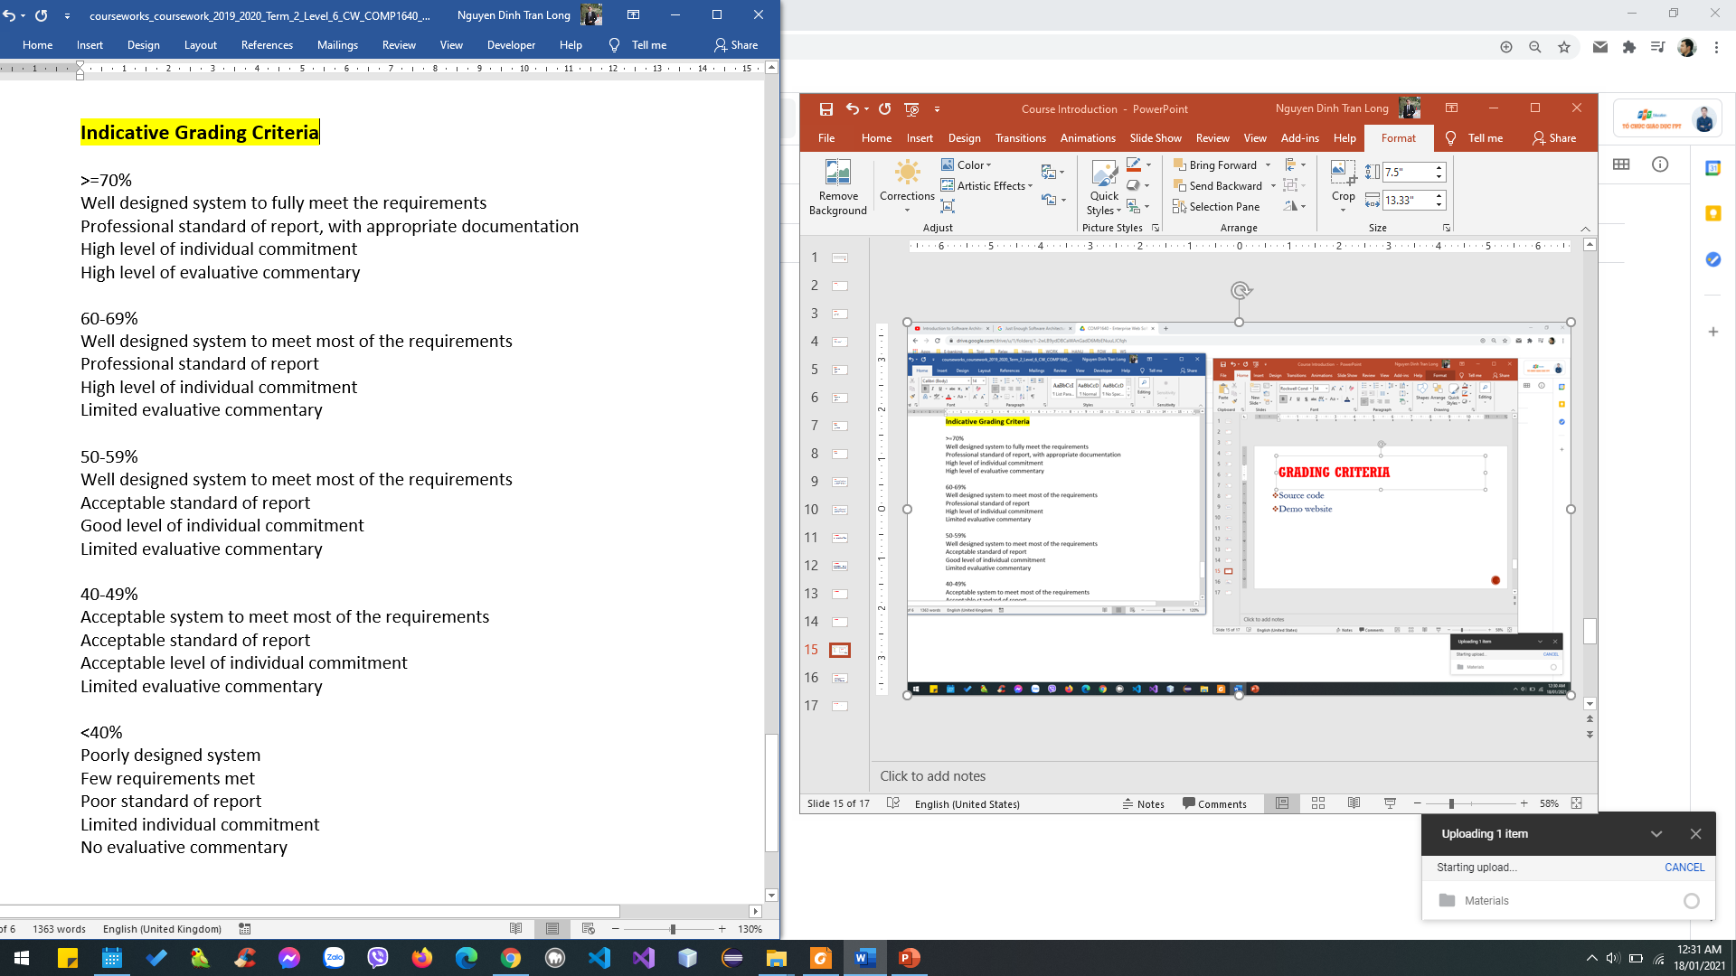
GRADING CRITERIA

Slide 15
IMPORTANCE
Coursework scenario & specification will be informed later
You must work in a group of 4-6 students
You are free to select web development technologies/frameworks
You must apply Scrum Agile methodology
Source code must be uploaded to GitHub
Screencast must be uploaded to YouTube
Demo website must be uploaded to a real host for demo & testing

Slide 16

GOOGLE CLASSROOM

